Slide 1
ROCKER ARM SPOT WELDING MACHINE

Slide 2
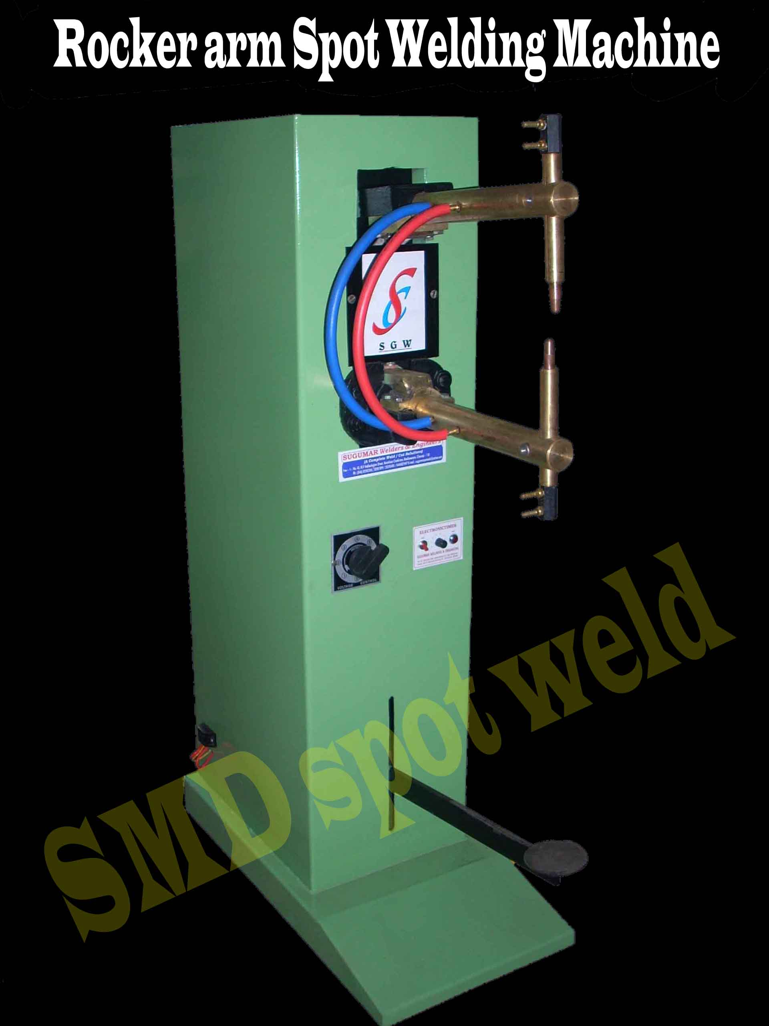

Slide 3
MANUAL FOOT OPERATED(pedal type)
PARAMETERS : PT-8 PT-10 PT-15 PT-20 PT-25
Ranging @ 50% duty cycle KVA : 8 10 15 20 25
Throat depth Cm : 25 30 30 30 30
Throat Clearance Cm : 20 20-30 20-30 20-30 20-30
Welding range max 2 X mm : 1.5 2.0 2.5 3.0 3.5
M.S.Sheet mini 2 X mm : 0.25 0.3 0.4 0.4 1.0
Short circuit current max Amps : 2500 5000 6500 8000 13000
Weight (approx) Kg : 95 145 170 195 220
Control : Electronic timer 5-50 Cycle & 1-10 Sec
Input Supply : 2 lines of 3 phase , 440 v AC , 50 Hz.
Water cooled Arms & Electrode : Water supply at 30 ^{O} C , pressure 2.1 kg / cm 2
9ltrs / min

